Slide 1
AV Audio Sessions

Slide 2
Overview
How does your App’s audio interact with other OS audio?
Affected by ring/silence switch?
Should other App’s music stop when your audio starts?
Should your audio duck when the phone rings?
What happens when someone docks their device?
AVAudioSession allows you to:
Setup input/output routing for your App
Determine how other App’s audio is mixed with yours
Handle interruptions (in audio) from other Apps
Broad categories exist that allow for typical (audio) behavior
7 categories: 1 for audio playback/recording

Slide 3
Defining an Audio Session
Audio Session singleton, owned by iOS
AVAudioSession *session = [AVAudioSession sharedInstance];
A singleton is only created once and only owned by one object
Useful for coordinating actions across a system
Default behavior: AVAudioSessionCategorySoloAmbient
Playback enabled, recording disabled
“Silence” switch turns off audio
When screen is locked, audio is silenced
Your audio sends a silence message to any other Apps with audio

Slide 4
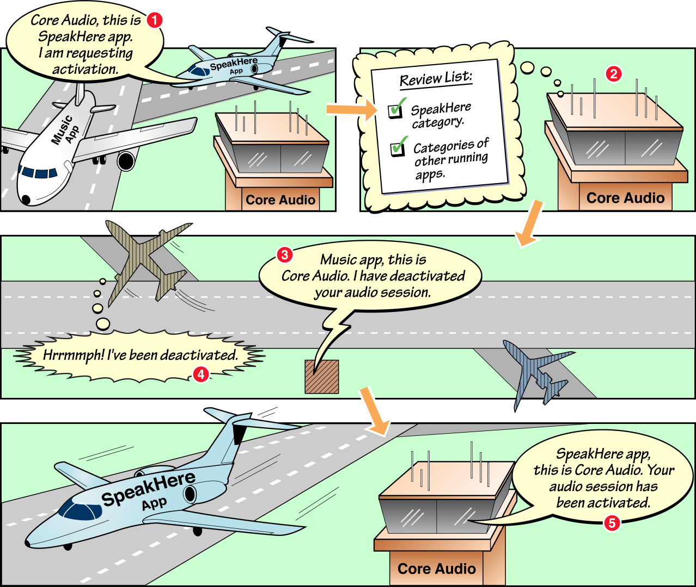
Core Audio is an airport now

Slide 5
Activating an Audio Session
When audio is playing, you should activate your Session
NSError *err= nil; BOOL success = [session setActive:YES error:&err]; if (!success) { … }
If de-activating (e.g., audio player stop), the just pass setActive:NO
Inform other Apps that may already playing audio
[session secondaryAudioShouldBeSilencedHint];
iTunes playing music, or phone call
Keep audio to a minimum (eg, silence background music)

Slide 6
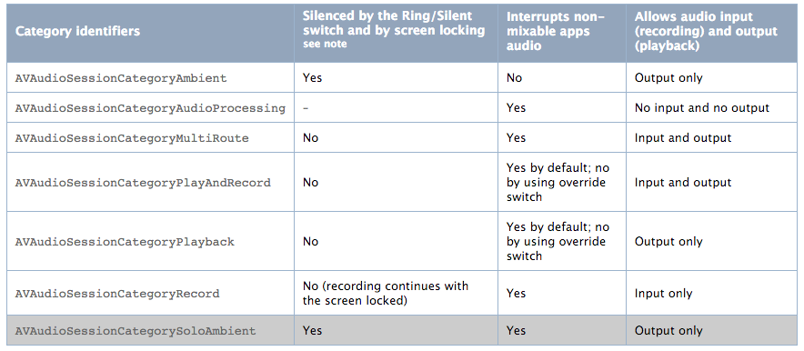
Setting a Category
A Category defines the Audio Session properties
AVAudioSessionCategoryPlayAndRecord – The input and output need not occur simultaneously, but can if needed
default

Slide 7
Setting a Category
Once the Session is created, set its category
NSError *err = nil;
BOOL success = [session setCategory:AVAudioSessionCategoryPlayAndRecord error: &err];

Slide 8
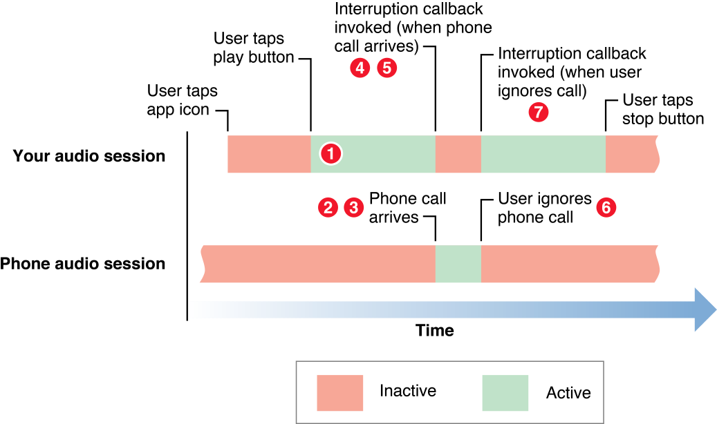
Responding to Interruptions
If the phone rings, or an alarm sounds (etc), this gives us an opportunity to behave gracefully in the presence of an overriding audio event (known as an interruption)
Use this callback to save any states, pause our audio, adjust the GUI, etc.
Notes:
1 Your app is active, playing back audio.
2 A phone call arrives. The system activates the phone app’s audio session.
3 The system deactivates your audio session. At this point, playback in your app has stopped.
4 The system invokes your interruption listener callback function indicating that your session has been deactivated.
5 Your callback takes appropriate action. For example, it could update the user interface and save the information needed to resume playback at the point where it stopped.
6 If the user dismisses the interruption—electing to ignore an incoming phone call in this case—the system invokes your callback method, indicating that the interruption has ended.
7 Your callback takes action appropriate to the end of an interruption. For example, it updates the user interface, reactivates your audio session, and resumes playback.

Slide 9
Registering for interruptions
[[NSNotificationCenter defaultCenter]
addObserver:self
selector:@selector(handleInterruption:)
name:AVAudioSessionInterruptionNotification
object:session];
- (void)handleInterruption:(NSNotification *)notification {
UInt8 intType= [[notification.userInfo valueForKey:AVAudioSessionInterruptionTypeKey] intValue];
if (intType==AVAudioSessionInterruptionTypeBegan) {…}
if (intType==AVAudioSessionInterruptionTypeEnded) {…}
}
Notes:
https://developer.apple.com/library/mac/documentation/Cocoa/Reference/Foundation/Classes/NSNotificationCenter_Class/#//apple_ref/occ/instm/NSNotificationCenter/addObserver:selector:name:object:

Slide 10
A note on interruptions
Apple done messed up with iOS 9…
In iOS 8, both the interrupt and end-interrupt methods were reliably called
Now in iOS 9, many developer’s are reporting that the end-interruption callback is not being reliably made
From the Apple documentation: “There is no guarantee that a begin interruption will have an end interruption.”
Hopefully this will be fixed in iOS 10

Slide 11
Audio Session Properties
Specify preferred hardware settings
sampling rate
preferred I/O buffer size
Query hardware characteristics
I/O latency
I/O channel count
Availability of input (mic)
Hardware sampling rate and volume settings
Response to device notifications

Slide 12
Audio Session Properties
Setting preferred sample rate
And buffer duration
Or get the sample rate from the hardware
NSError *audioSessionError = nil;
double sampleRate = 44100.0
[session setPreferredSampleRate:samplerate
error:&audioSessionError];
NSTimeInterval bufferDuration =1024/44100;
[session setPreferredIOBufferDuration:bufferDuration
error:&audioSessionError];
double sampleRate;
sampleRate = [session currentHardwareSampleRate];

